Slide 1
Cosmic Ray Lifetime Study
A measurement of Special Relativity
Richard Lasky – Summer 2010

Slide 2
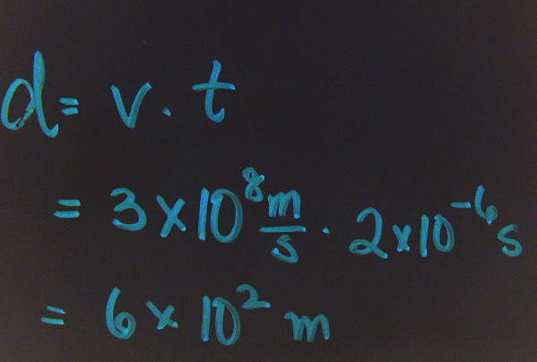
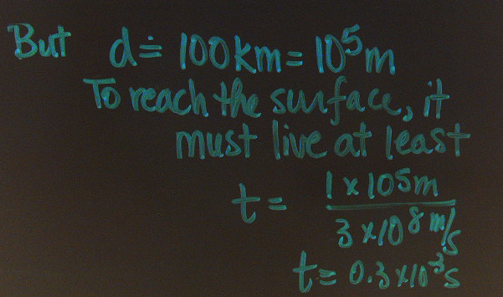
The Theory
Muons are formed from collisions of cosmic rays with the atmosphere.
Because they are unstable, they should decay as they travel to our detectors.
However, relativistic effects extend their lifetime, allowing us to measure the rest lifetime of a muon in a slab of our detector.
Assume for the moment that a muon has a 2 microsecond lifetime. If it travels close to the speed of light, classically it should move only 600 meters before it decays.
To reach the surface, a muon must “live” about 0.3 ms or
Conclusion: The muons we detect from the edge of space must travel so close to the speed of light that their lifetimes are greatly extended.
In fact, we make the assumption that they are “still new” when we finally stop them with our detector so that we can measure their full “rest lifetime.”

Slide 3
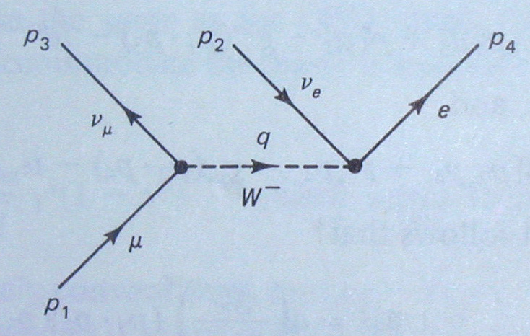
So, if we can stop a muon, we can measure essentially its rest lifetime in the material.
As shown in this Feynman diagram, a muon decays into a muon neutrino and – by a W⁻ boson mediating a weak interaction -- into an electron and an antielectron neutrino
The net reaction is:
Both the muon and the electron can interact with the scintillation material to give off a light pulse we can use to trigger a timer to determine the lifetime of the muon.

Slide 4
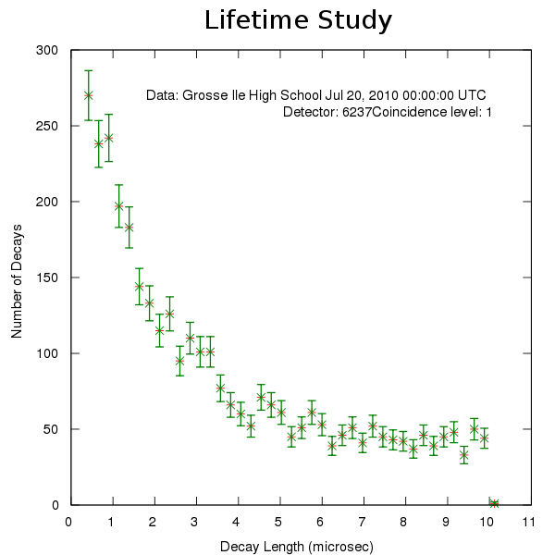
Graph Resulting from Lifetime Study

Slide 5
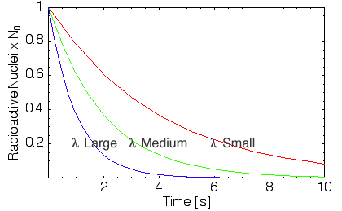
Decay of the Muons in the detectors related to Radioactive Decay Law
λ = decay constant
http://www.youtube.com/watch?v=515BlcHomw8&feature=related

Slide 6
Setup for experiment
Detectors should be in stacked array
Set d = 2 and w = 401
W = gate window
d = TMC delay

